Slide 1
CLASS 02: BASIC DATA STRUCTURES IN PYTHON

Slide 2
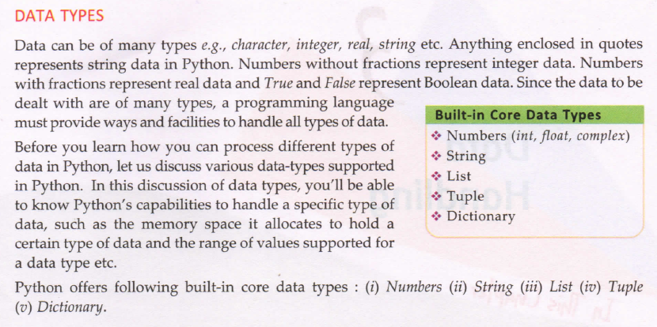
Notes:
Use type()

Slide 3
Numbers
They are immutable
Types:
Integers
Integers(Signed) eg. 12,34,5,0,1001,34
Boolean eg. 0,1
Floating Point Numbers(15digit precision)
Fractional Form(Decimal) eg.23.3, 4.0, 45,99
Exponent Notation eg. 3.0545E03, 350.230E02
Complex Numbers eg. 2+3j,-2.3j …. J = root(-1)
.real attribute
.imag attribute

Slide 4
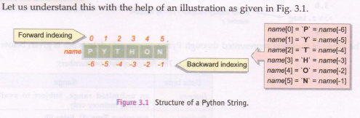
String
Sequence of character enclosed in single quotes or double quotes.
Eg : ‘abcd’, “123”,”#@$%:”,’answer1’
Character can be accessed using indexes
They are immutable.

Slide 5
List
Comma separated values of any datatype between square brackets
Eg= [1,2,3,4], [‘a’,’b’,’c’], [‘abs’,’a1’,1,’a’]
Empty list = [] or list()
They are mutable
Tuple
Comma separated values of any datatype between angle brackets
Eg= (1,2,3,4), (‘a’,’b’,’c’), (‘abs’,’a1’,1,’a’)
Empty Tuple: () or tuple()
They are immutable

Slide 6
Set
Comma separated values of any datatype between curly brackets or braces.
Eg= {1,2,3,4}, {‘a’,’b’,’c’}, {‘abs’,’a1’,1,’a’}
Empty set : set()
They are mutable (non-substitutable).
Dictionary
Unorders set of Comma separated key:value pairs, of any datatype between square brackets
Key should be unique
Eg= {1:’a’,2:’e’,3:’I’,4:’o’}
{’a’:1,’e’:2,’I’:3,’o’:4}

Slide 7
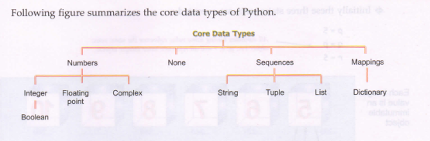

Slide 8
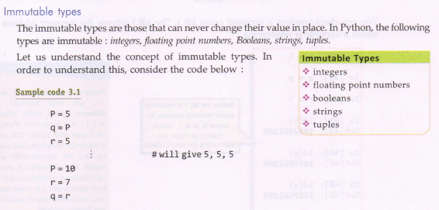
Notes:
Use id()

Slide 9
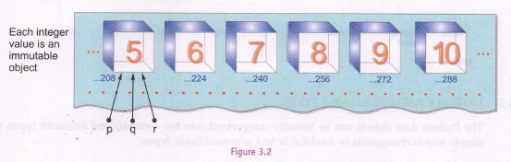
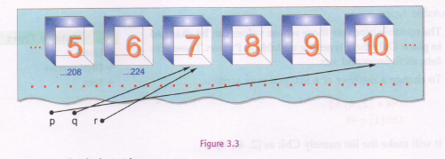

Slide 10
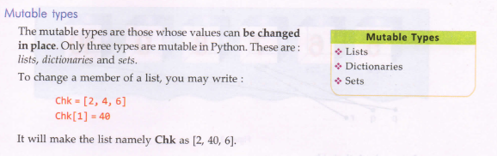

Slide 11
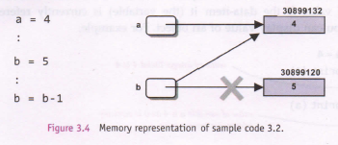
Test This…!!

Slide 12
OPERATORS (<,>,floor division(//))
Explain difference between ‘is’ and ‘==‘

Slide 13
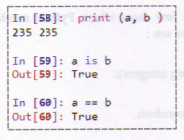
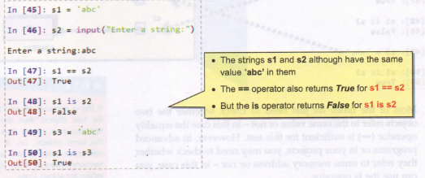

Slide 14
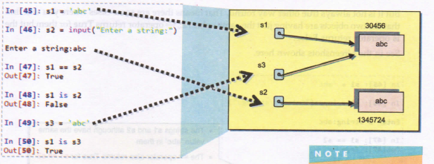

Slide 15
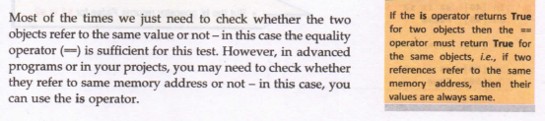

Slide 16
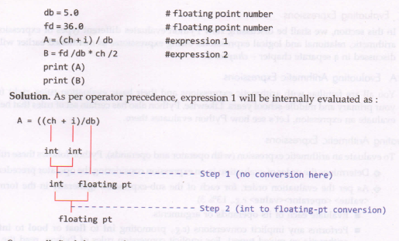

Slide 17
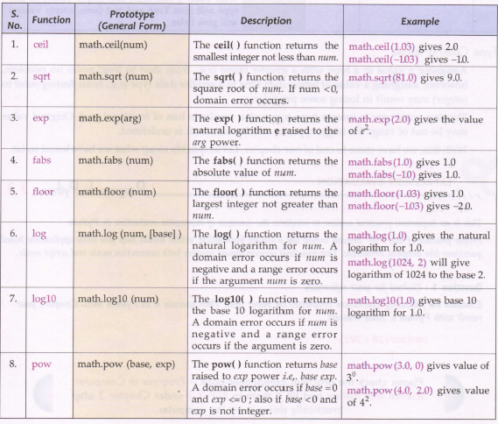

Slide 18
